Slide 1
Python Podcast & GitHub Reputation
Project Luther - Metis
January 25th, 2019
Moritz Eilfort

Slide 2
Task
Predict the influence a python podcast has on the ”reputation” of a GitHub repository.
”reputation” = Star count

Slide 3

Data
Podcast: talkpython.fm
GitHub Repositories mentioned
GitHub API:
Repository Info
Star count history

Slide 4
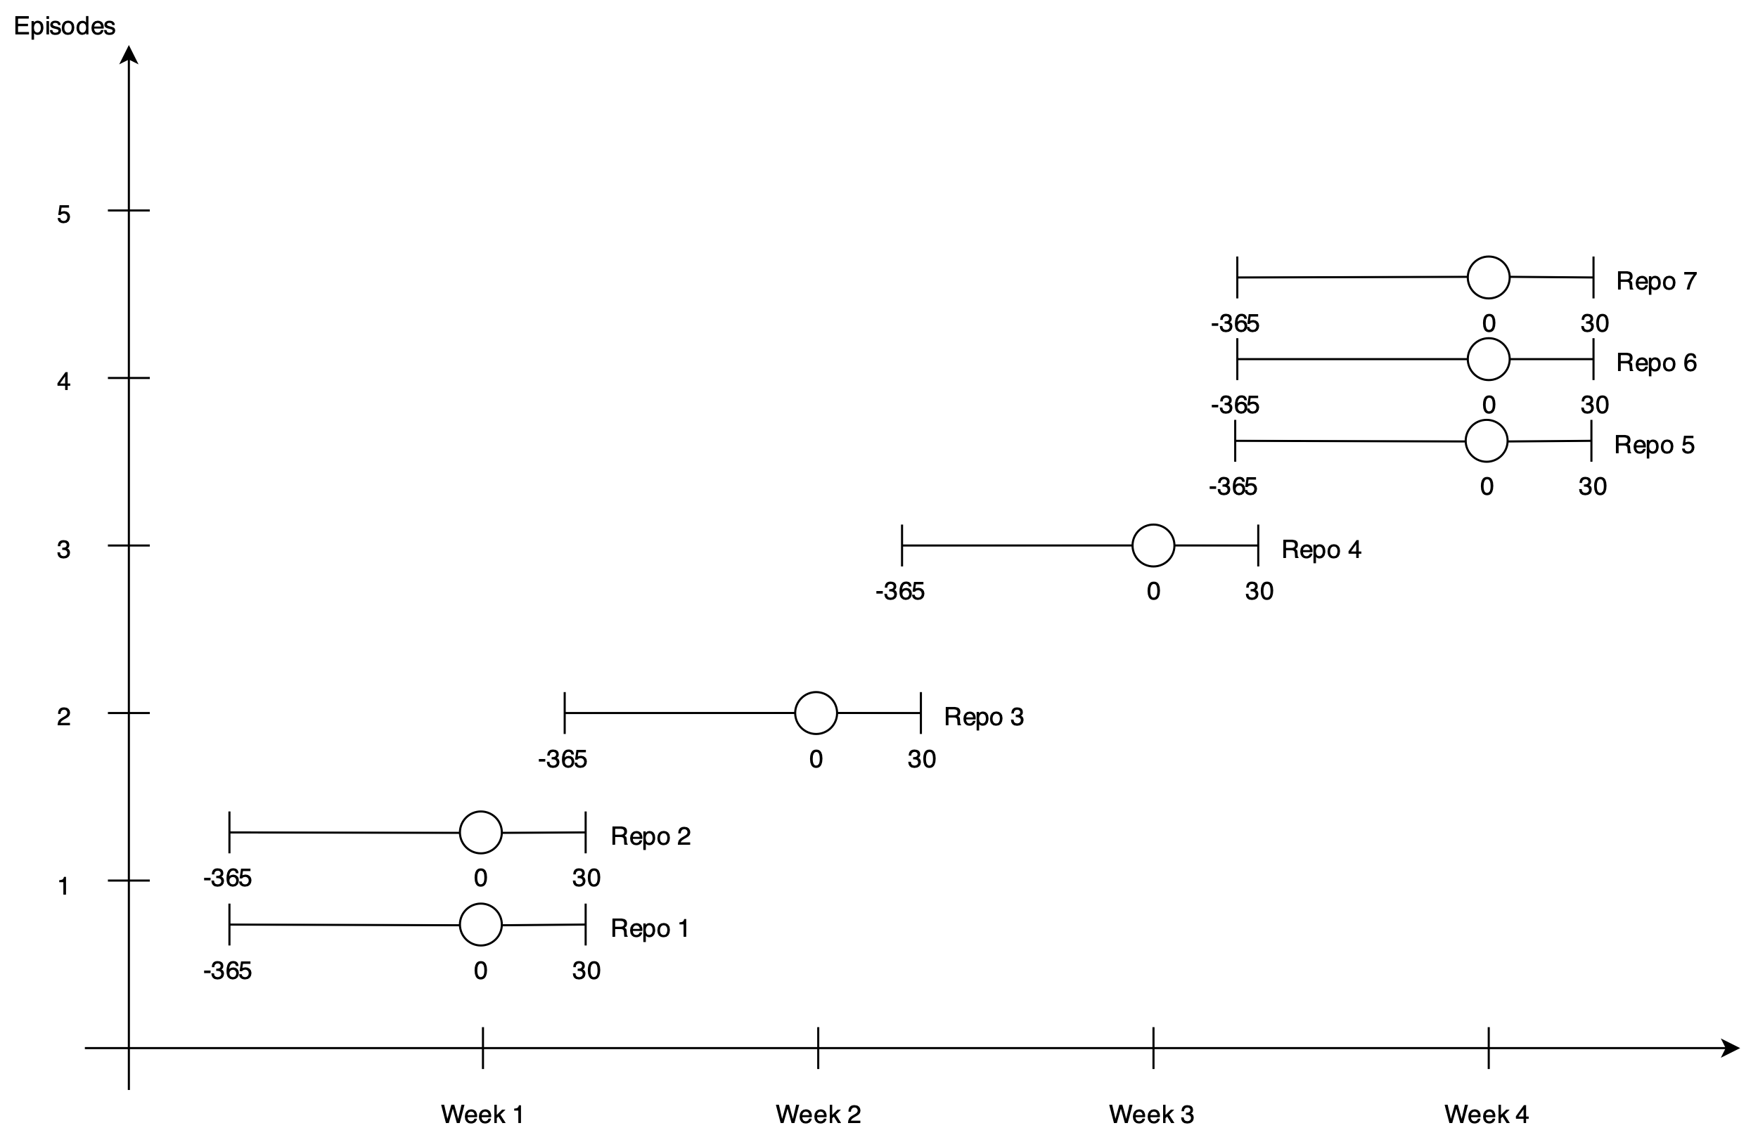

Slide 5
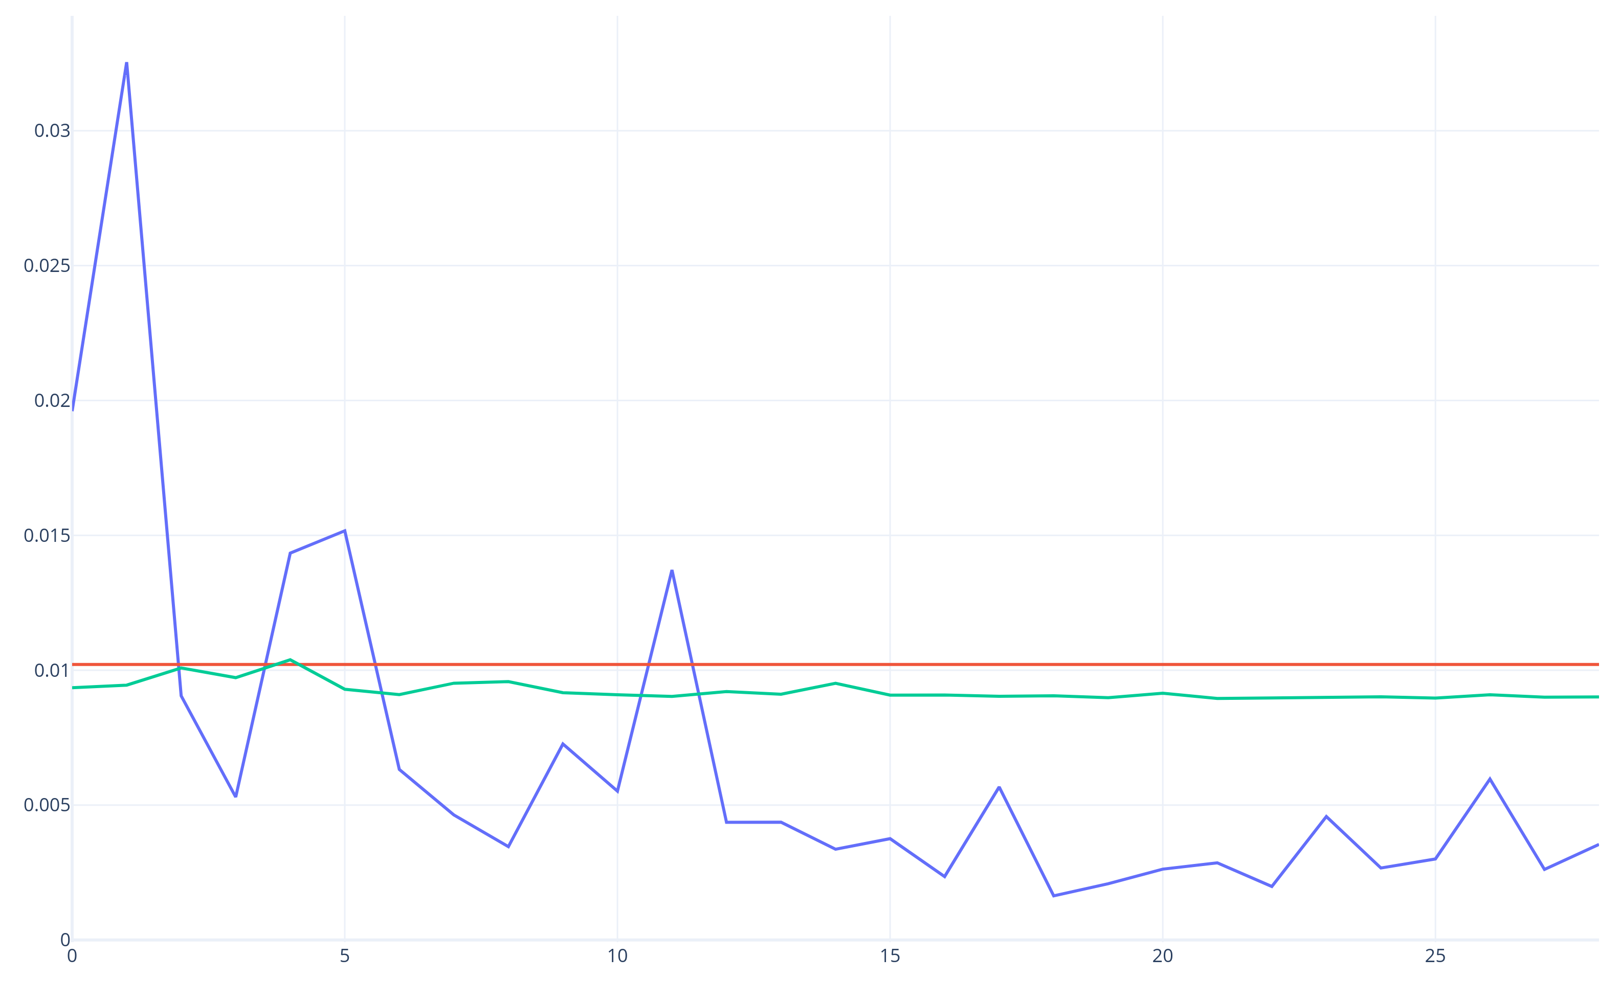
Results
Actual Values
Mean
Predictions
Rel. Star Count Increase
Days after Mention

Slide 6
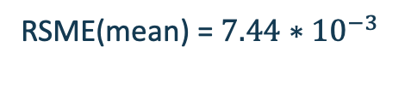

Results
Actual Values
Mean
Predictions
RSME(mean) =$7.44∗{10}^{−3}$
RSME(AR(2)) =$6.93∗{10}^{−3}$
Rel. Star Count Increase
RSME(mean) > RSME(AR(2))
Days after Mention

Slide 7
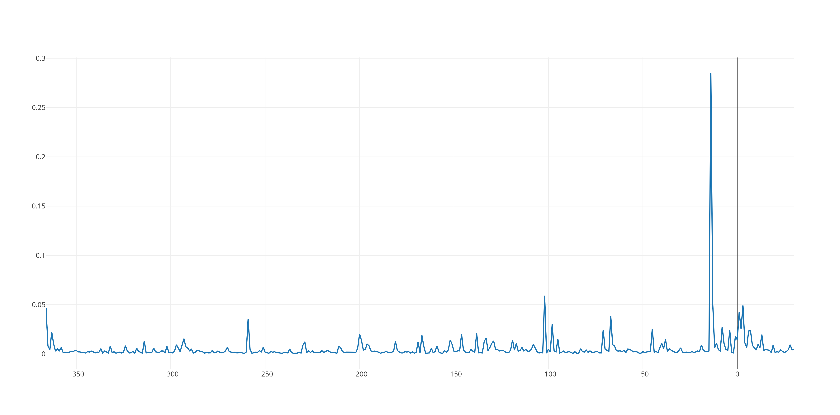
Results
Averaged relative star counts over all repositories
Star-count increas relative to repo size
Days relative to date mentioned

Slide 8
Conclusion
Slightly better predictions than the mean
RSME(mean) > RSME(AR(2))
It is more likely that GitHub “reputation“ influences a Podcast Mention not the reverse

Slide 9
Future Work
Investigate other Metrics
PyPi downloads
Audience Size per Episode
Include multiple podcasts

Slide 10
Thank you for listening!
Code and Presentation: github.com/JimFawkes/luther

